Slide 1



UNIVERSITY INSTITUTE OF ENGINEERING
COMPUTER SCIENCE ENGINEERING
Bachelor of Engineering
Design and Analysis of Algorithms(CST-302/ITT-302)
Prepared By: Amrita Chaudhary (E8745)
Topic: Minimum Spanning Tree
DISCOVER . LEARN . EMPOWER

Slide 2
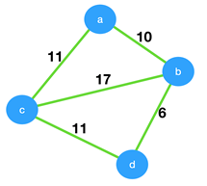
Poll Question
1) Consider the given graph.
What is the weight of the minimum spanning tree using the Prim’s algorithm,starting from vertex a?
a) 23
b) 28
c) 27.
d) 11

Slide 3
Poll Question
2) Prim’s algorithm is a ______
a) Divide and conquer algorithm
b) Greedy algorithm
c) Dynamic Programming
d) Approximation algorithm

Slide 4
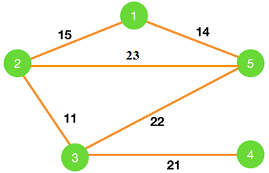
Poll Question
3) Consider the graph shown below.
Which of the following edges form the MST of the given graph using Prim’s algorithm, starting from vertex 4.
a) (4-3)(5-3)(2-3)(1-2)
b) (4-3)(3-5)(5-1)(1-2)
c) (4-3)(3-5)(5-2)(1-5)
d) (4-3)(3-2)(2-1)(1-5).

